Slide 1
SB 1383 Community Webinar:
Organic Waste Recycling
and Food Recovery
May 9, 2022
Notes:
Good afternoon La Quinta residents and businesses!
Thank you for your participation in today’s webinar about Senate Bill 1383, the Short-Lived Climate Pollutants Law, and how this will affect you in La Quinta.
Let’s go over some housekeeping items first before proceeding with today’s agenda.

Slide 2
Webinar Housekeeping
This webinar is being recorded and will be posted on the City’s website, along with these presentation slides
Only the panelists will be able to unmute, all others will be muted
If not a panelist, please keep your video off
Type your questions into the Chat box at any time or email them to us afterward
Contact information will be available at the conclusion
Notes:
This webinar is being recorded and will be posted on the City’s website, along with these presentation slides.
Only the panelists will be able to unmute, all others will be muted.
If not a panelist, please keep your video off.
Type your questions into the Chat box at any time or email them to us afterward.
Contact information will be available at the conclusion.

Slide 3
Agenda
Introductions
Current Recycling Regulations
SB 1383 Overview
Residential Implementation Timeline
Contamination
Q & A
Conclusion
Notes:
Here is the Agenda for today’s webinar.
The panelists will introduce themselves
W will discuss current recycling regulations
Go over SB 1383 for residents and businesses
Provide a residential implementation timeline
Discuss recycling contamination
Conduct a Q & A session
and the Conclusion with next events and contact info

Slide 4
Introductions
Clara Vera
Municipal Marketing Manager
Mike Veto
District Environmental Coordinator
Reyna Camarena
Management Assistant
City Manager’s Office
Jeremy Griffin
Management Specialist
City Manager’s Office
Notes:
And now our panelists for today from the City of La Quinta and Burrtec.
My name is Reyna Camarena. I’ve been with the City for ____ years and I’m a Management Assistant in the City Manager’s Office. I . . . . .
My name is Jeremy Griffin. I’ve been with the City for almost a year. I’m a Management Specialist in the City Manager’s Office and assist the City Manager in multiple areas including Waste & Recycling programs, Legislative Analysis, and Affordable Housing.
My name is Clara Vera. I’m the Municipal Marketing Manager at Burrtec, the contracted waste hauler for the City. I . . . .
My name is Mike Veto. I’m the District Environmental Coordinator at Burrtec, representing all La Quinta waste and recycling needs. I . . . . .

Slide 5
California Recycling Laws
Overview
CalRecycle
City of La Quinta
Burrtec Waste and Recycling Services
Why we are here today
Notes:
Clara

Slide 6
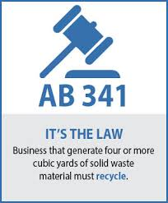
AB 341: Mandatory Business Recycling
Assembly Bill 341 (AB 341)
July 1, 2012, a business (includes public entities) that generates 4 cubic yards or more of commercial solid waste per week or is a multifamily residential dwelling of five units or more shall arrange for recycling services.
AB 341 does not mandate a diversion goal for businesses - it simply requires that they implement a commercial recycling program.
Notes:
Clara

Slide 7
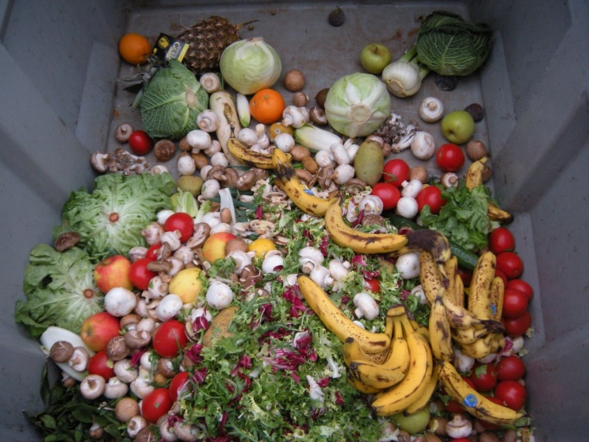
AB 1826: Mandatory Commercial Organics Recycling
Assembly Bill 1826 (AB 1826)
In October 2014, Governor Brown signed AB 1826 Chesbro (Chapter 727, Statutes of 2014), requiring businesses to recycle their organic waste.
In September 2020, CalRecycle reduced the threshold to 2 cubic yards of solid waste.
Notes:
Clara

Slide 8
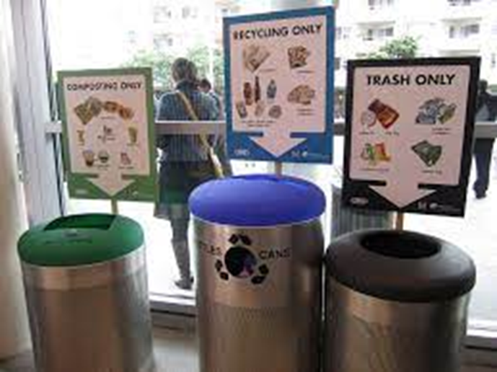
AB 827: Mandatory Recycling Front-of-House
Assembly Bill 827 (AB 827)
July 1, 2020, Commercial Recycling Requirements (New): AB 341 and AB 1826-covered businesses must provide organics and recycling containers at front-of-house to collect waste generated from products purchased and consumed on the premises.
These containers must be placed adjacent to trash and be visible, easily accessible, and clearly marked.
Notes:
Clara

Slide 9
SB 1383 Legislation and Methane Reduction
CalRecycle video retrieved April 6, 2022, from https://calrecycle.ca.gov/organics/slcp/
Notes:
This video from CalRecycle explains California’s climate issues and how SB 1383 policies will help reduce these adverse effects. The video is 3-minutes long.

Slide 10
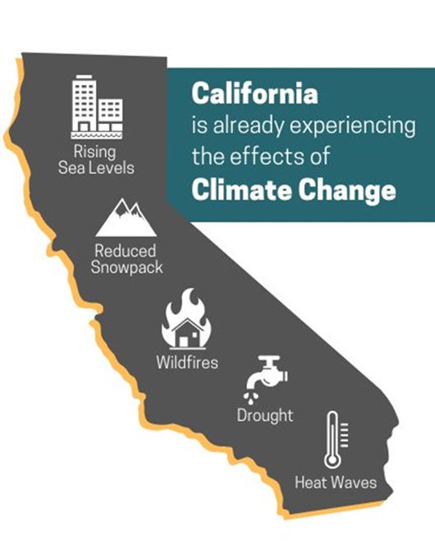
SB 1383 Legislation and Methane Reduction
Statewide effort to reduce emissions of short-lived climate pollutants
Reduce organic waste disposal 75% by 2025
Increase edible food recovery 20% by 2025
Cities must establish organics recycling programs for all commercial and residential properties
Notes:
Why is SB 1383 important?
Organic waste in landfills emit 20% of the state’s methane, a super pollutant 84 times more potent than carbon dioxide.
Organic waste makes up 1/3 of what Californians send to landfills.
The State is committed to reducing these harmful super-pollutants, improving the health of all, and creating green jobs.
Some cities in CA already have residential organic waste separation and collection services. SB 1383 mandates that all remaining CA cities do the same starting in 2022.

Slide 11
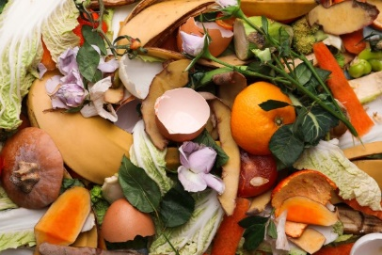
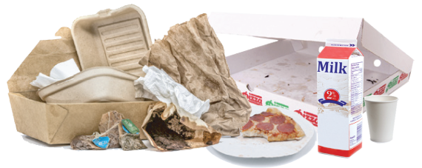
What is Organic Waste?
Food Waste
Food scraps
Uneaten or partially eaten food
Bones, eggshells, coffee grounds
Soiled Paper and Cardboard
Greasy pizza boxes
Paper napkins, towels, plates
Green Waste
Landscape and pruning
Leaves and lawn trimmings
Notes:
What is Organic Waste?
You may already be aware of Green Waste such as landscape debris and lawn trimmings.
Organic Waste includes these items as well as food waste, soiled paper, and soiled cardboard.
Food Waste includes food prep scraps before the meal and what is left on the plate after the meal.
Soiled Paper and Cardboard means greasy pizza boxes and paper plates, cups, and napkins.

Slide 12
Commercial Sector
SB 1383 Short-Lived Climate Pollutants
Notes:
Clara

Slide 13
What is Edible Food Recovery?
Collecting edible food that would otherwise go to landfills
Edible food donations must meet food safety standards
Commercial edible food generators must arrange to recover their edible food
Notes:
Donating unused food to a local food bank always helps out the community’s neediest, but SB 1383 only mandates businesses to start an Edible Food Recovery program.
Edible food includes food not used or sold due to its appearance, age, freshness, grade, or surplus.
Feeding hungry people through food recovery is the best use for surplus food, while reducing the waste thrown into landfills.

Slide 14
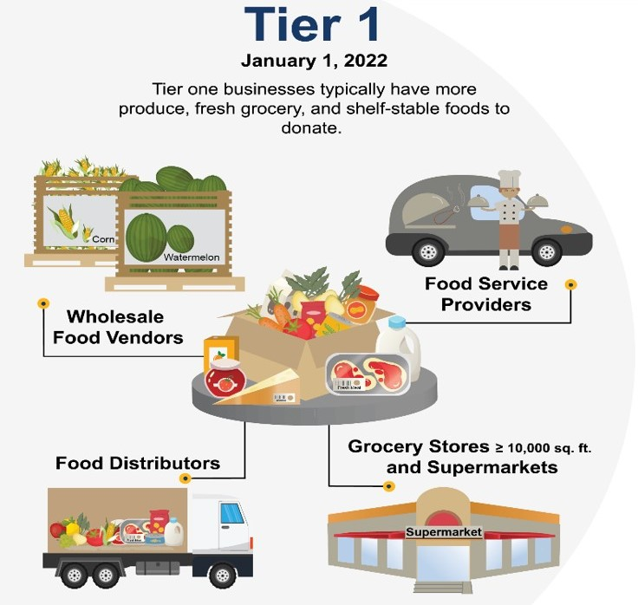
Tier 1 Edible Food Generators
Notes:
There are two types of Commercial Edible Food Generators, with different start dates for their mandated Edible Food Recovery.
Tier 1 Generators are the larger food businesses such as supermarkets, grocery stores, and food distributors. These organizations should already have arrangements as of January 2022 for donating their unused and unsold edible food.
Some businesses choose to back-haul, or self-haul, their food items back to their warehouses for follow-on distribution and donation.

Slide 15
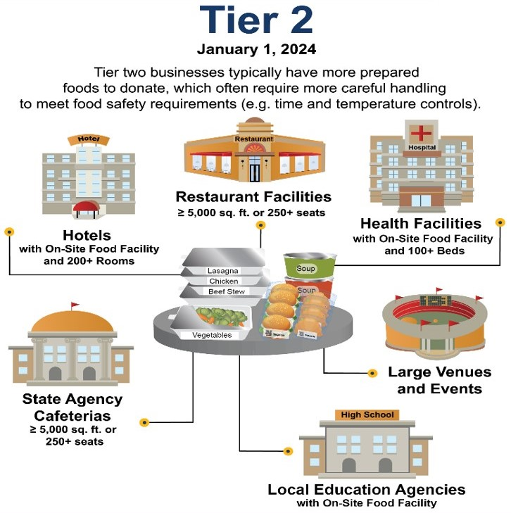
Tier 2 Edible Food Generators
Notes:
Tier 2 Generators handle large quantities of prepared foods on a regular basis such as large hotels and restaurants, school districts, hospitals, sports venues, and large events.
These organizations will have to start arranging for edible food donation by January 2024.

Slide 16
RESIDENTIAL Sector
SB 1383 Short-Lived Climate Pollutants
Notes:
Clara

Slide 17
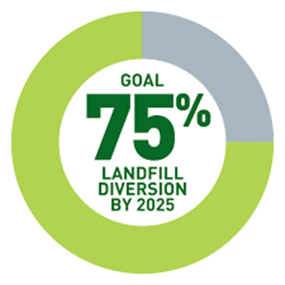
SB 1383: Short-Lived Climate Pollutants
Residential Sector
SB 1383 requires all residents, including multi-family communities, to have an organics program and participate
Requires the State to standardize the recycling program equipment colors
Requires Cities to provide a recycling organics program
Educate (Bilingual)
Monitor
Ultimately Enforce by 2024
Notes:
Clara

Slide 18
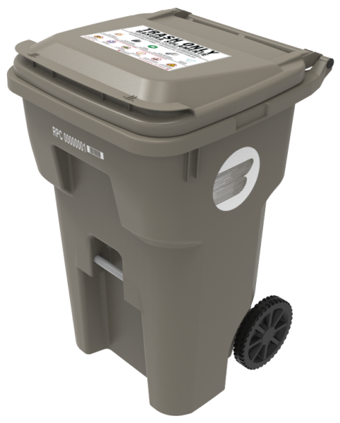
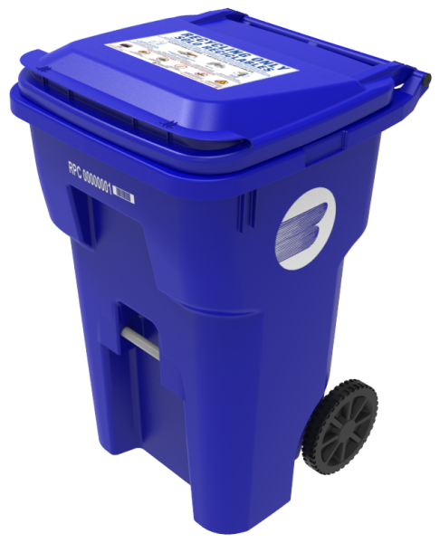
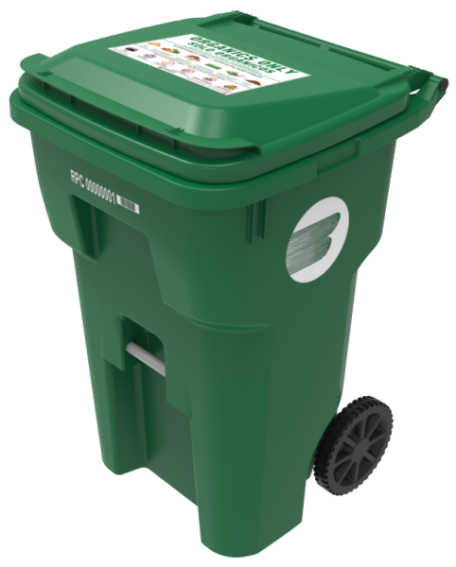
Standardized Bin Colors
Landfill Waste
Mixed Recyclables
Organic Waste
Notes:
If you came out to the City’s 40th Birthday Event on April 30th, you probably saw these new containers and colors.
SB 1383 also mandates standardized waste and recycling containers across California. A person in San Diego should immediately recognize the same container colors as someone in Sacramento, regardless of the waste hauler used. Some exceptions apply such as containers used to prevent wildlife entry or to withstand severe weather.
The Gray container will be the universal color for Landfill Waste.
The Blue container will be the universal color for Mixed Recyclables.
The Green container will be the universal color for Organic Waste, which includes Food Waste, Green Waste, and Soiled Paper and Cardboard.

Slide 19
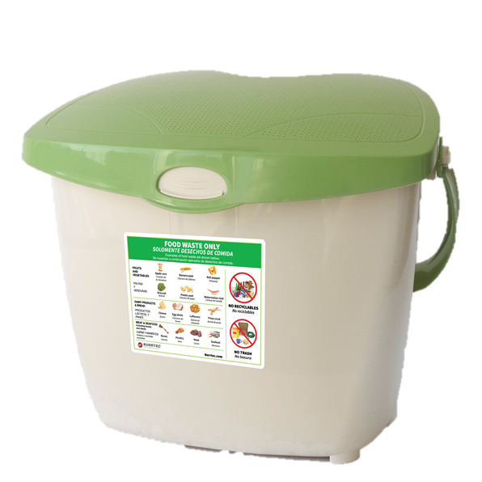
Virtual Food Scraps
Residential Food Waste Program
Includes a Green Organics Cart
Includes a food waste kitchen pail
Notes:
Clara

Slide 20
Chicken Soup - Ingredients for Chicken Soup - Food prepping and chopping
Virtual Food Scraps
Notes:
Clara

Slide 21
Food Scraps
Banana Peels, Chicken Bones, Cilantro, Potato Peels, Shallots, Onions, Garlic
Notes:
Clara

Slide 22
Food Scraps
Empty ingredients into a lined kitchen pail
Notes:
Clara

Slide 23
Food Scraps
Empty kitchen pail bag into your Green organics bin
You are now an expert – High Five!
Notes:
Clara

Slide 24
SB 1383 Residential Implementation Timeline
Residents will receive a notice via U.S. Mail 30 days prior to program starting
Residents will receive Educational Kits
Residents will receive Organics Program Equipment
Continued Outreach and Support
FALL OF 2022
Notes:
Clara

Slide 25
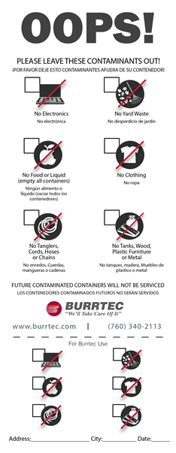
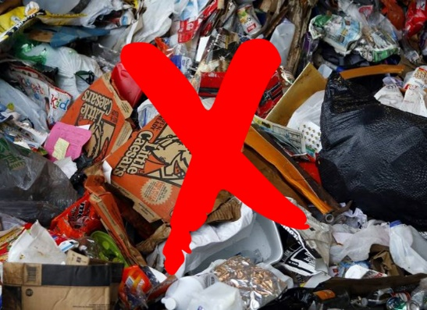
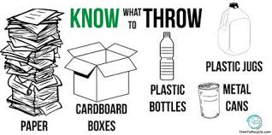
Contamination
Recycle right and avoid contamination fees
Contamination occurs when the wrong items are placed in your recycling program
Notes:
Clara

Slide 26
Q & A
Please type your question into the chat box. You can send the question to everyone or directly to the host.
We will read and answer as many questions as we can in the remaining time
If you have further questions, please email them to the City at GoingGreen@laquintaca.gov
Contact Burrtec Customer Service at (760) 340-2113 or CustomerService@burrtecdesert.com
Notes:
Now that you have seen the presentation and heard from the experts, what questions do you have?
Please type your questions into the Chat box. You can send your question to Everyone or directly to the Host. We will answer as many as we can in the remaining time, stopping around 3:55 to wrap up the webinar with the next events and our contact info.

Slide 27
Next Webinar and Workshop Dates
Webinar (online)
Wednesday, July 13, 2022, from 5:00 – 6:00 PM
Location: Zoom
Workshop (in person)
Saturday, October 22, 2022, from 10:00 – 11:00 AM
Location: TBD
Notes:
Here are our upcoming webinar and workshop dates. We will cover additional topics at each so please attend and spread the word to your family, friends, and neighbors.
The next webinar will be held July 13th and later in the evening from 5-6 PM.
We expect to conduct an in-person workshop with demonstrations on Saturday, October 22nd, from 10-11 AM. The location is still TBD but we’ll let you know where at least a month prior.

Slide 28
City Recycling Website
www.LaQuintaCA.gov
Click on the Waste &
Recycling button
Notes:
If you haven’t seen it recently, please check out our newly remodeled City Recycling website at LaQuintaCA.gov. Then click on the Waste & Recycling button to get to the recycling page.
This new website contains lots of useful information for residents and commercial businesses, including collection services and rates, bulky item pick-up, organic waste, SB 1383, Household Hazardous Waste items and drop-off events, energy conservation tips, and plenty of recycling resources from National, State, and Local organizations.

Slide 29
Thank you!
We appreciate your participation!
Website: https://www.laquintaca.gov
Email: GoingGreen@laquintaca.gov
Phone: (760) 777-7046
Website: https://www.burrtec.com/
Email: CustomerService@burrtecdesert.com
Phone: (760) 340-2113
Notes:
Thank you once again for your participation today! We hope you learned more than you knew coming in about SB 1383.
Please visit the City and Burrtec websites for more information. You can also send us an email anytime or call with a question about SB 1383 or anything else on Waste and Recycling programs and services.
Thank you and have a great rest of the day!

